Slide 1
Wine Quality Prediction
CS19643 - FOUNDATIONS OF MACHINE LEARNING PROJECT
BY
LOKESHWAR S CSE B (220701146)
Guide
Dr.V.Auxilla Osvin Nancy..,M.Tech..,Phd..,

Slide 2
Introduction
The Wine Quality Prediction project aims to develop a machine learning-based model that accurately predicts the quality of wine based on its physicochemical features such as acidity, residual sugar, chlorides, pH, and alcohol content. By utilizing a supervised learning approach, the system is trained on historical wine datasets to classify wine into quality categories (e.g., good or bad).
The project involves key stages including data preprocessing, feature selection, and model training using algorithms like XGBoost, Support Vector Machine, and Logistic Regression. Evaluation metrics such as confusion matrix, classification report, ROC-AUC score, and feature importance are used to assess model performance.
The ultimate goal is to assist wine producers and analysts in making data-driven decisions and enhancing product consistency and quality using AI-driven insights.

Slide 3
Literature Survey
Numerous research efforts have been undertaken to predict wine quality using machine learning techniques. In a study by Cortez et al. (2009), various regression and classification models were applied on the UCI wine dataset, where Support Vector Machines and Decision Trees provided promising accuracy.
Subsequent works introduced ensemble methods such as Random Forest and XGBoost, which significantly improved prediction capabilities by reducing variance and overfitting. Researchers also explored feature selection and normalization techniques to enhance model performance, highlighting the importance of attributes like alcohol content and volatile acidity.
Deep learning models have also been applied in recent years, although they require larger datasets and computational resources. These studies collectively demonstrate that machine learning can serve as a robust approach to automate and improve the evaluation of wine quality, replacing subjective and labor-intensive traditional methods.

Slide 4
Literature Survey
Dataset Overview The UCI Wine Quality Dataset contains 11 physicochemical properties and a quality score rated by experts. It is widely used for predictive modeling of wine quality in both academic and industrial research.
Model Comparisons in Past Studies Researchers have applied Decision Trees, Random Forest, SVM, and ANN models. Random Forest showed better accuracy due to its ensemble nature, while ANNs provided promising results but required extensive tuning.
XGBoost Effectiveness Studies found XGBoost to be highly effective for wine quality prediction, offering high accuracy, fast processing, and strong handling of missing data. Its success in structured data problems supports its use in this project.

Slide 5
Objectives
To Predict Wine Quality Accurately: Develop a machine learning model that can classify the quality of wine (e.g., good or bad) based on physicochemical features.
To Analyze and Preprocess the Dataset: Perform cleaning, handling missing values, encoding, scaling, and feature selection for optimal model performance.
To Compare Multiple ML Algorithms: Evaluate classifiers like XGBoost, Support Vector Machine, and Logistic Regression to identify the most effective model.
To Assess Model Performance with Metrics: Use Confusion Matrix, Classification Report, and ROC-AUC to evaluate and compare model accuracy and robustness.
To Visualize Results for Better Understanding: Provide visual representations (like feature importance, ROC curves) to help interpret model outcomes.
To Identify Key Features Affecting Wine Quality: Determine which physicochemical factors (like alcohol, acidity) most influence the quality predictions.

Slide 6
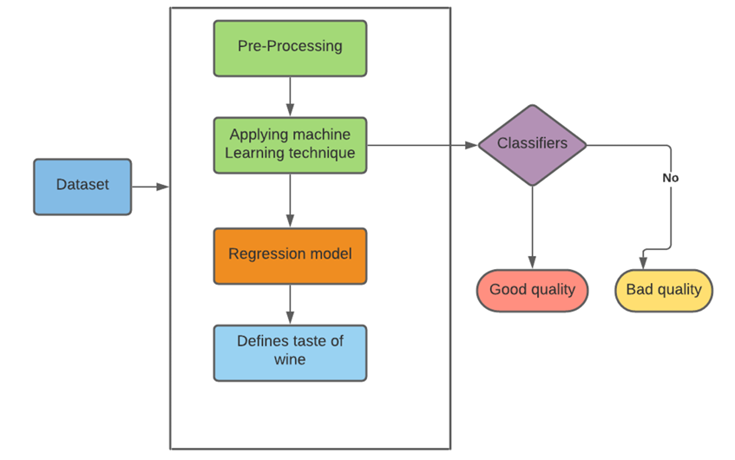
System Architecture

Slide 7
Methodology
The methodology of this project begins with collecting a wine quality dataset comprising various physicochemical features and quality labels. The dataset undergoes preprocessing, which includes handling missing values, encoding categorical data, normalizing the features through scaling, and selecting the most relevant features for improved accuracy.
After preprocessing, the data is split into training and testing sets to evaluate model performance effectively. Three machine learning models—XGBoost Classifier, Support Vector Machine (SVM), and Logistic Regression—are trained on the dataset. Their performance is then assessed using a confusion matrix, classification report, and ROC-AUC score to determine the most accurate model.
Finally, the selected model is used to predict wine quality, with visualizations provided for feature importance and prediction outcomes to enhance interpretability.

Slide 8
Methodology
Data Collection
Use a wine quality dataset with features like acidity, sugar, pH, etc.
Data Preprocessing
Handle missing values
Encode categorical variables
Scale features for normalization.
Select important features.
Data Splitting
Split data into training and testing sets.
Model Building
Train models using XGBoost, Support Vector Machine (SVM), and Logistic Regression.
Model Evaluation
Evaluate performance using Confusion Matrix, Classification Report, and ROC-AUC Score.
Prediction and Output
Predict wine quality based on trained model.
Visualize results and feature importance.

Slide 9
Implementation
The implementation of the Wine Quality Prediction project begins with loading the dataset and performing data preprocessing steps such as handling missing values, encoding categorical data, feature scaling, and selecting relevant features. The processed data is then split into training and testing sets to build and validate the models.
Machine learning algorithms including XGBoost, Support Vector Machine (SVM), and Logistic Regression are trained on the training data. Each model is evaluated using metrics like accuracy, ROC-AUC score, confusion matrix, and classification report to identify the best-performing model.
Finally, the selected model is used to predict wine quality, and the results are visualized to provide meaningful insights.

Slide 10
Implementation
1. Data Collection
The dataset used for this project is the Wine Quality Dataset obtained from the UCI Machine Learning Repository. It contains physicochemical properties of red and white wine samples such as fixed acidity, volatile acidity, citric acid, residual sugar, and more. Each sample is also labeled with a quality score ranging from 0 to 10, which serves as the target variable for prediction.
2. Data Preprocessing
Before training the models, the dataset undergoes several preprocessing steps. Initially, missing or null values are identified and handled appropriately—either by imputation or removal. Categorical values, if present, are encoded using label encoding or one-hot encoding methods. Next, feature scaling is applied to normalize the data for better performance of machine learning algorithms. Feature selection techniques are also used to identify and retain only the most significant attributes that influence wine quality.
3. Data Splitting
The processed dataset is then split into training and testing sets to evaluate model performance. A standard train-test split ratio of 80:20 is used, where 80% of the data is used to train the models and 20% is used for testing their accuracy and generalization capability.

Slide 11
Implementation
4. Model Building
Multiple classification models were developed and tested for predicting wine quality:
XGBoost Classifier: Known for its high performance and speed, it was trained with hyperparameter tuning for best results.
Support Vector Machine (SVM): Chosen for its effectiveness in high-dimensional spaces.
Logistic Regression: Used as a baseline model for binary or multi-class classification.
Each model was trained using the training dataset and fine-tuned to improve performance.
5. Model Evaluation
After training, the models were evaluated using different performance metrics:
Confusion Matrix: Provided insights into true positives, true negatives, false positives, and false negatives.
Classification Report: Included precision, recall, F1-score, and support for each class.
ROC-AUC Curve: Showed the trade-off between true positive rate and false positive rate, helping identify the best-performing model.

Slide 12
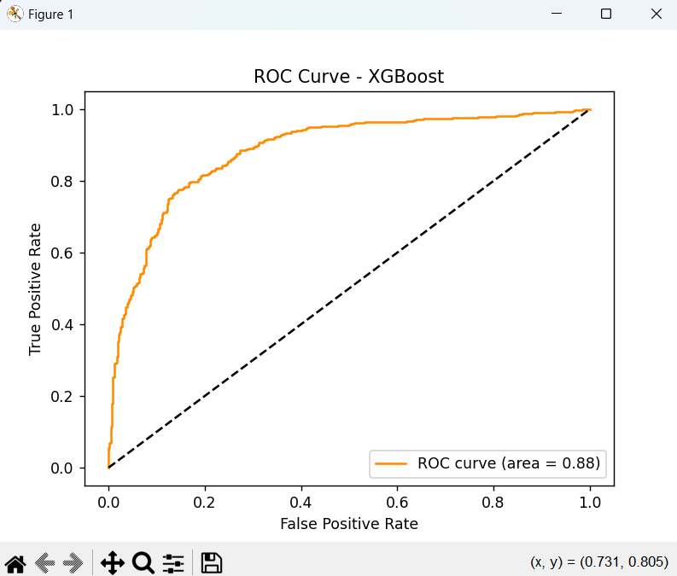
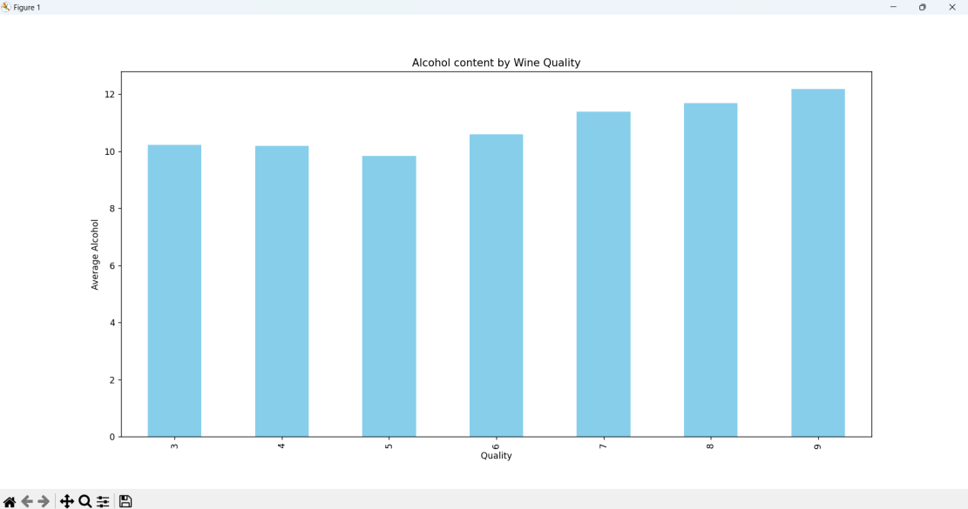
Implementation
6. Results and Visualization
The predicted wine quality for each sample was outputted and visualized using various charts:
Feature Importance Graphs: Helped understand which features most influenced the predictions.
ROC Curve: Illustrated the classification capability of each model.
Bar Graphs: Compared model accuracies and other metrics for better interpretation.

Slide 13
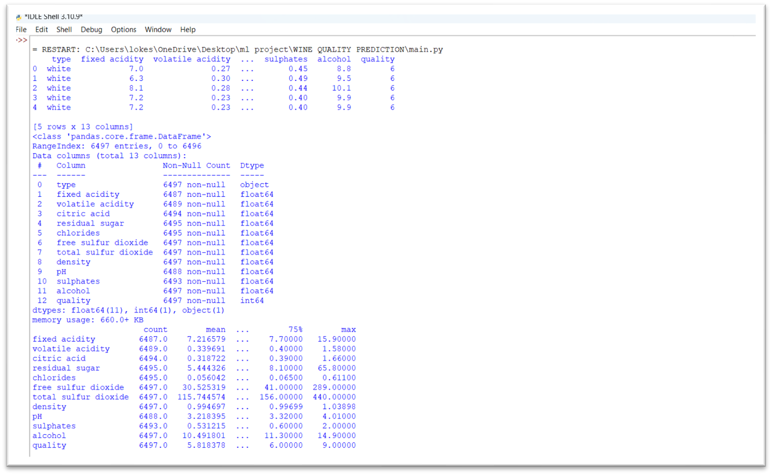
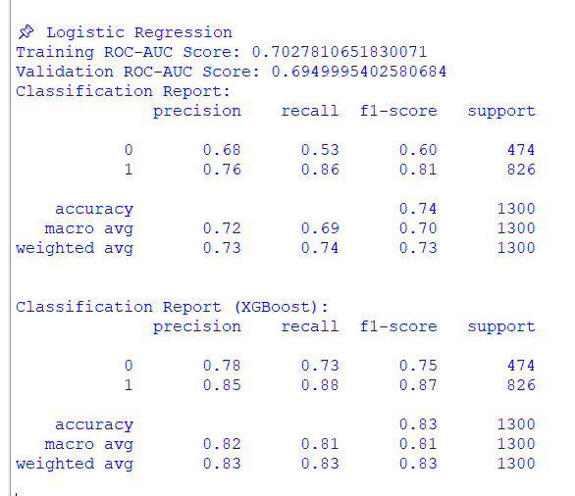
Results
DATA EXPLORATION AND SUMMARY STATISTICS

Slide 14
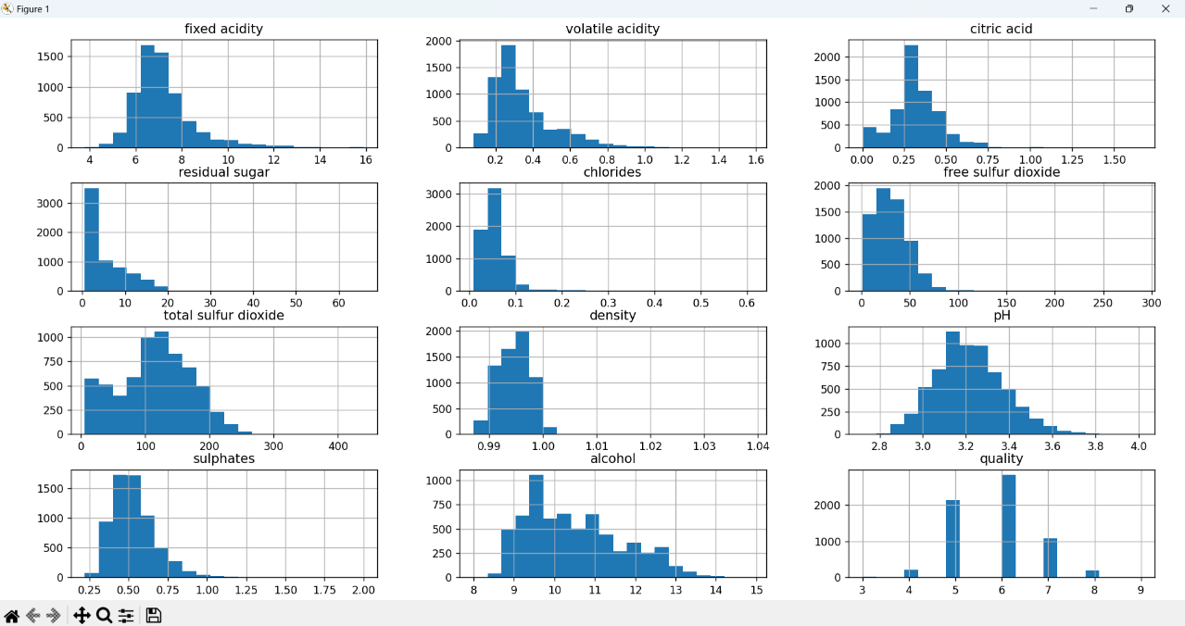
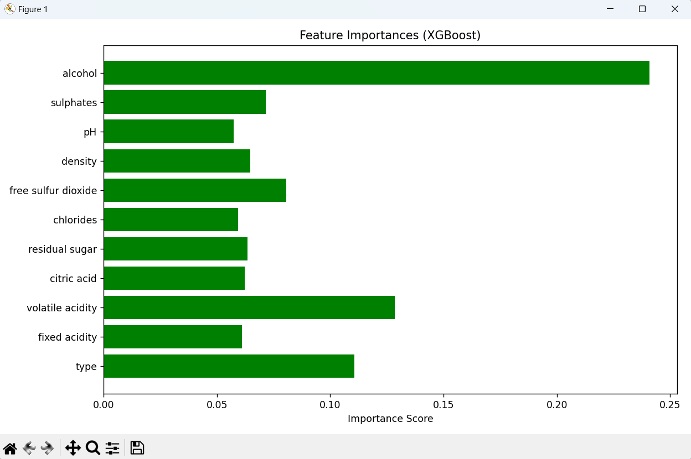
Results
FIG: Distribution of numerical features in wine dataset
FIG: XG-Boost Feature Importances

Slide 15
Comparison with existing work
Traditional wine quality prediction systems have primarily relied on basic machine learning algorithms like Decision Trees, k-Nearest Neighbors, or Naive Bayes. These approaches often suffer from limited accuracy and minimal data preprocessing, leading to suboptimal results. Moreover, earlier works generally overlook critical steps like proper handling of missing values, feature scaling, and robust evaluation techniques.
In contrast, our proposed system introduces a more comprehensive and data-driven approach by incorporating advanced models such as XGBoost, Support Vector Machine, and Logistic Regression. Our methodology includes detailed data preprocessing, effective feature selection, and in-depth model evaluation using metrics like ROC AUC Score, Confusion Matrix, and Classification Report.
Additionally, we provide visual interpretations of feature importance and predicted outcomes, making our system not only more accurate but also more insightful and user-friendly than many existing solutions.

Slide 16
Conclusion and Future Work
In conclusion, this project successfully demonstrated the use of machine learning techniques particularly XGBoost, Support Vector Machine, and Logistic Regression for predicting wine quality based on physicochemical features. Through effective preprocessing, feature selection, and model evaluation, the system achieved a high level of accuracy and reliability, as evidenced by ROC AUC scores and classification metrics. The project highlights the importance of data quality and model selection in predictive analytics.
For future enhancements, the system can be extended by incorporating deep learning models or ensemble approaches to further improve accuracy.
Additionally, deploying the model into a user-friendly web or mobile application can make it accessible for wine producers and quality analysts. Integration with real-time data and feedback mechanisms can also help the model continuously improve and adapt to evolving wine quality standards.

Slide 17
References
ML Based Predictive modelling for enhancing Wine quality:
https://www.nature.com/articles/s41598-023-44111-9
UCI Machine Learning Repository. (2009). Wine Quality Data Set. https://archive.ics.uci.edu/ml/datasets/wine+quality
Prediction of Wine Quality using Machine Learning Algorithms:
https://www.researchgate.net/publication/350110244_Prediction_of_Wine_Quality_Using_Machine_Learning_Algorithms
4) Red Wine Quality Prediction using Machine Learning Techniques:
https://ieeexplore.ieee.org/document/9104095

Slide 18
References
Dataset has been taken from following link: https://www.kaggle.com/datasets/yasserh/wine-quality-dataset
Reference Links:
Geeks for Geeks: https://www.geeksforgeeks.org/wine-quality-prediction-machine-learning/
XGBoost: https://www.geeksforgeeks.org/xgboost/
Support Vector Machine: https://www.geeksforgeeks.org/support-vector-machine-algorithm/
LOGISTIC REGRESSION: https://www.geeksforgeeks.org/understanding-logistic-regression/

Slide 19
THANK YOU

